Slide 1

ECE 383 – FPGA Karaoke
C2C Mark A. Demore II
DFEC

Slide 2
Problem Statement
Problem: We don’t get to hear Jolly’s beautiful pipes in the lab.
Bigger Problem: Karaoke is becoming less and less popular among millennials. Karaoke machines are too limited in their song libraries, and often sound like cheesy instrumental covers.

Slide 3
Technical Objective
Objective: Using the Nexys Video FPGA, create a karaoke machine that can strip the vocals from any song played through the LINE IN port. Display an FFT plot on the screen for further entertainment. Add microphone input to be amplified and output with the voice-stripped audio to a speaker.

Slide 4
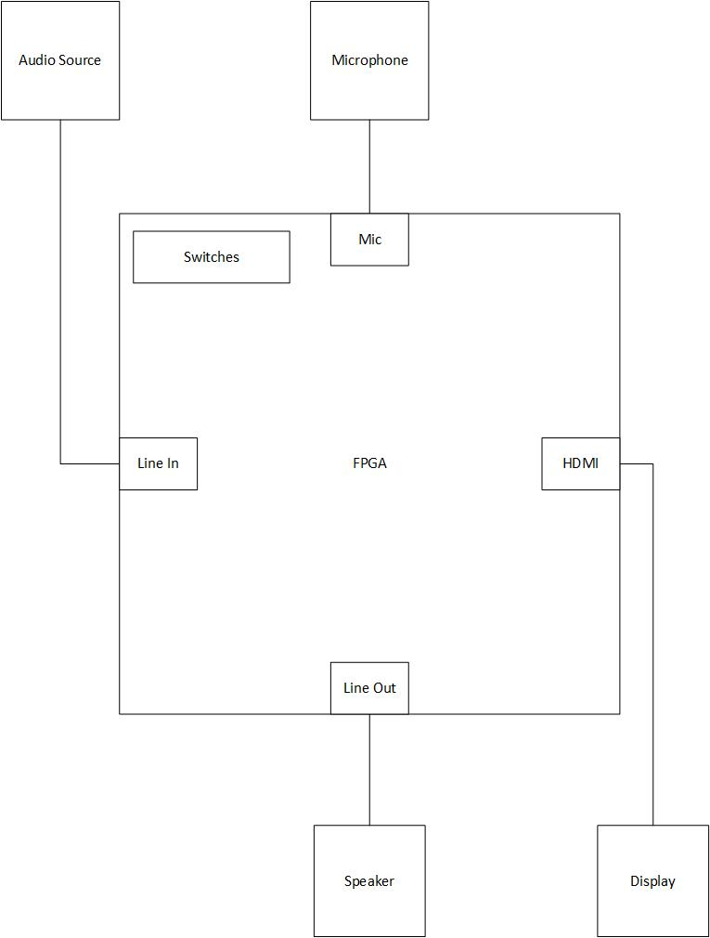
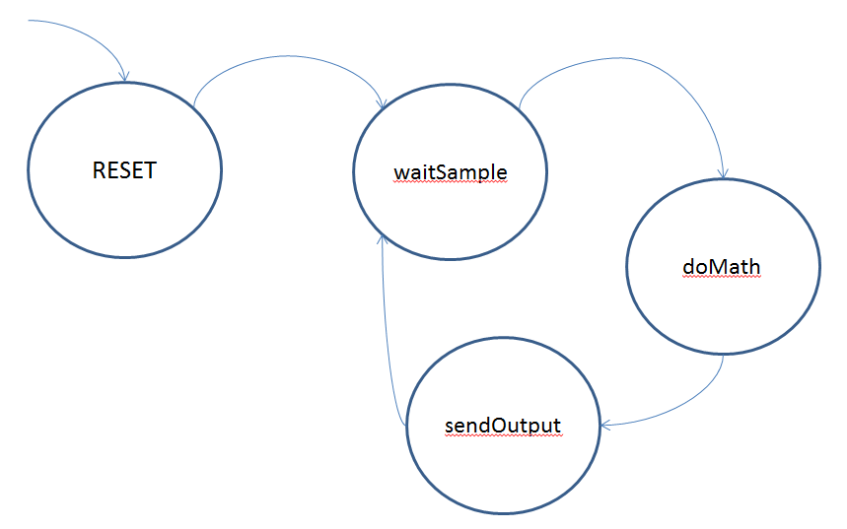
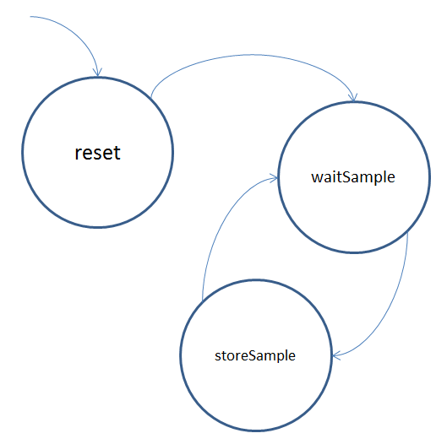
Top Level Design
Seemingly simple…

Slide 5
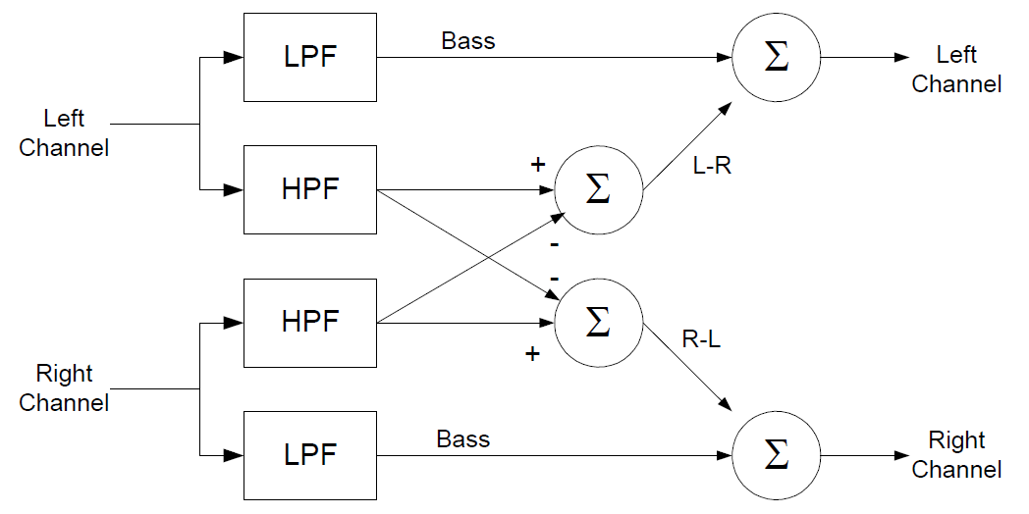
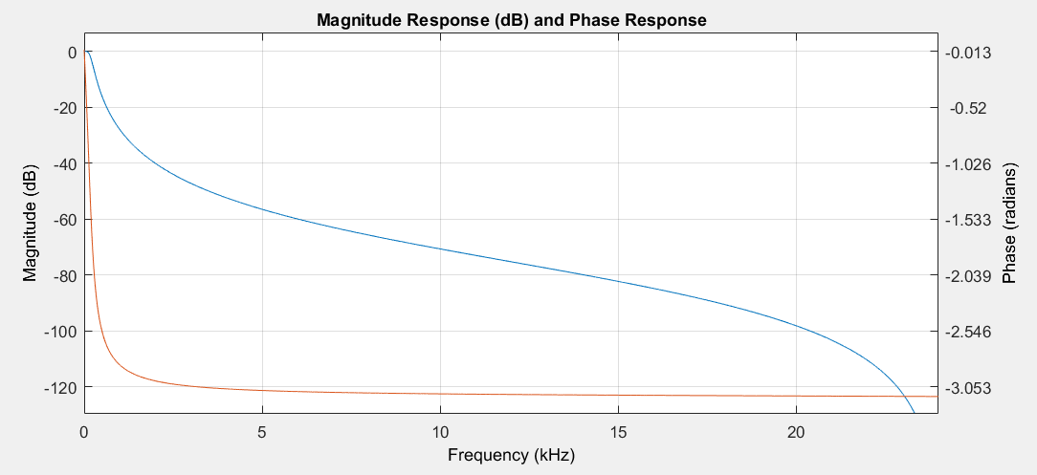
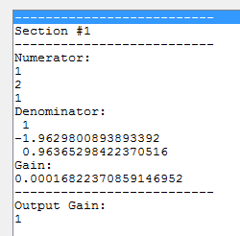
Voice-Stripping

Slide 6
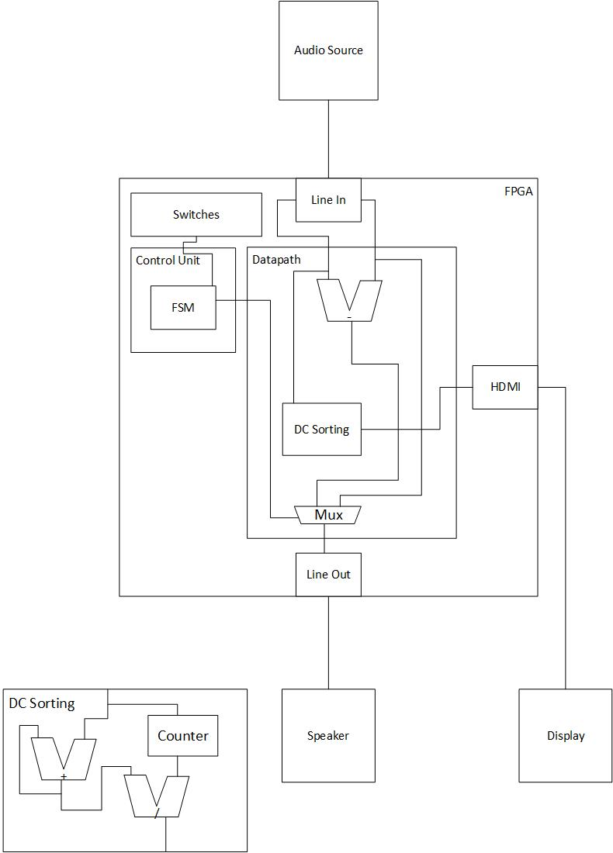
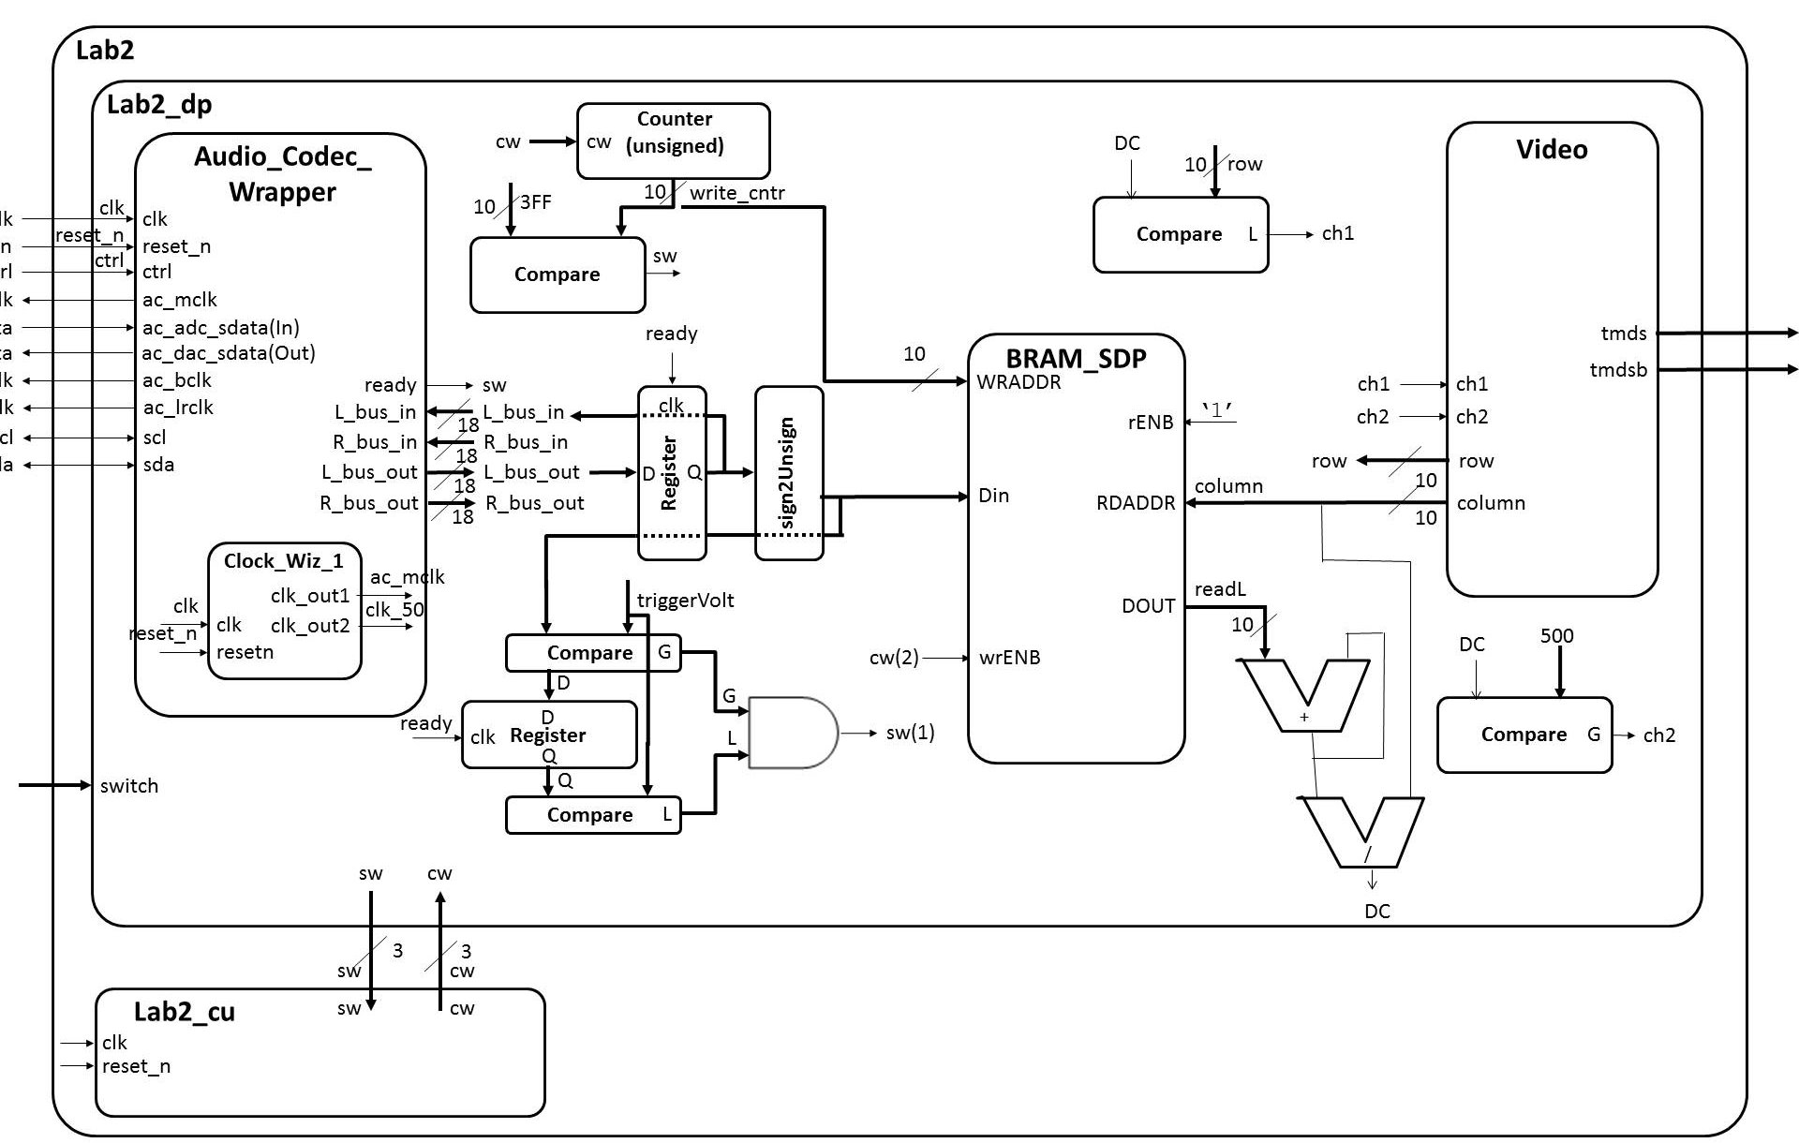
Detailed Design

Slide 7
Demonstration of Functionality
Demo
Margaritaville

Slide 8
Lessons Learned
Do more detailed research
Take extra time in design
If you think you know how it works and just start slapping it all together, it probably won’t work
Find creative ways to simplify the problem and come up with new solutions

Slide 9
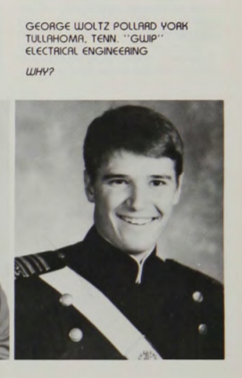
Acknowledgements
Joshua Jalowiec – Vocalist
Luke McFadden – Videographer, Dancer
USAFA C’19 Computer Engineers
Dr. George “GWIP” York

Slide 10
Questions?

